Slide 1
ART 4 & AP
By: Heather Pfannenschmidt

Slide 2
Breadth
A section of the AP Studio Art Portfolio, which consists of 12 works that demonstrate a mastery of skills whilst showing artistic range.

Slide 3
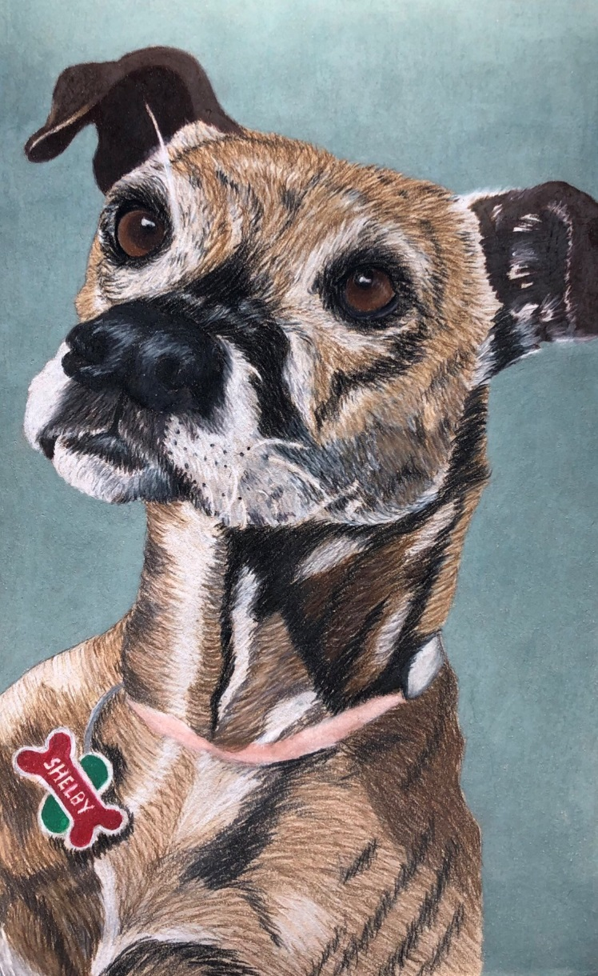
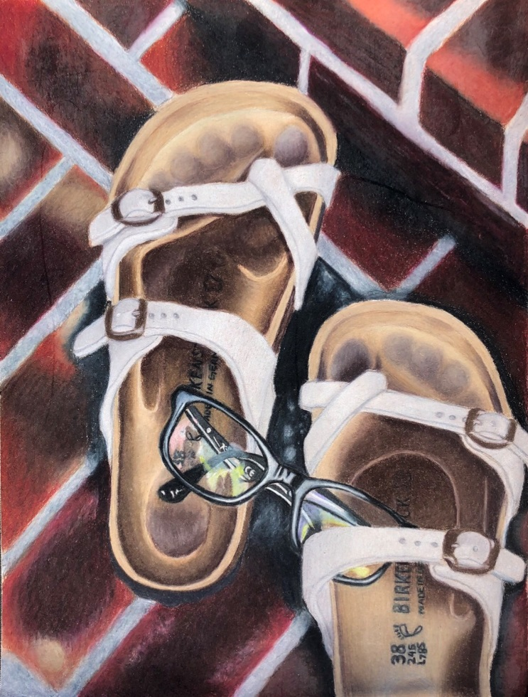
Left: Birkenstocks – Prisma
Right: My Dog – Prisma

Slide 4
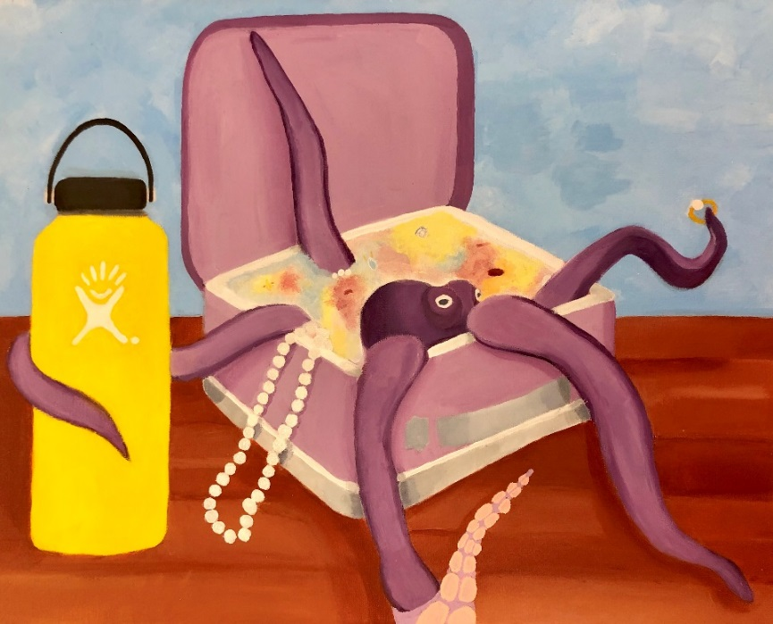
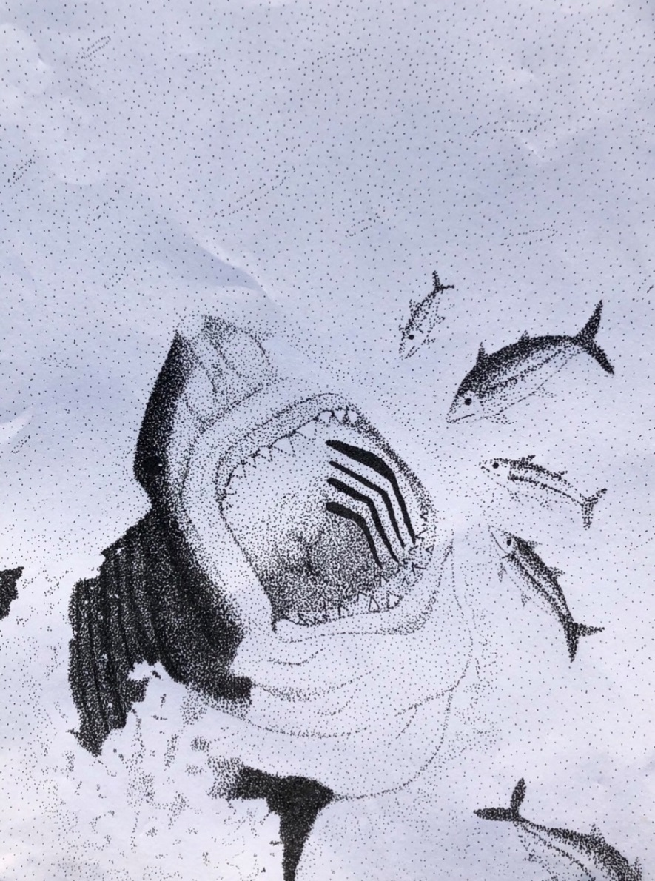
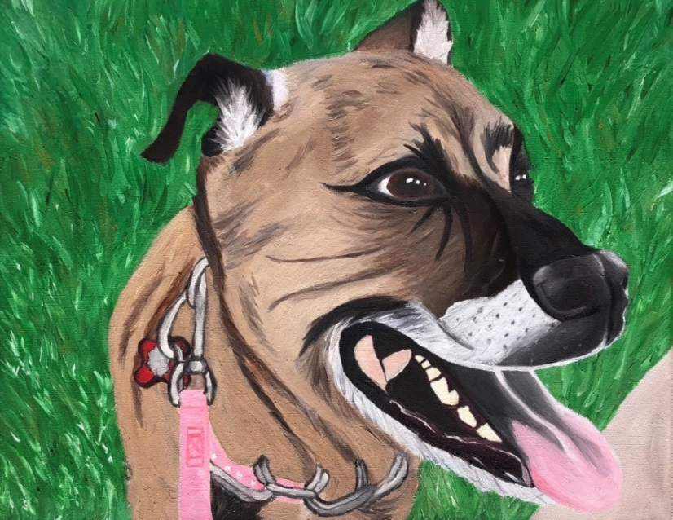
Left: A Shark – Pen & Ink
Top: Octopus In a Lunchbox – Acrylic
Bottom: My Dog – Oil Paint

Slide 5
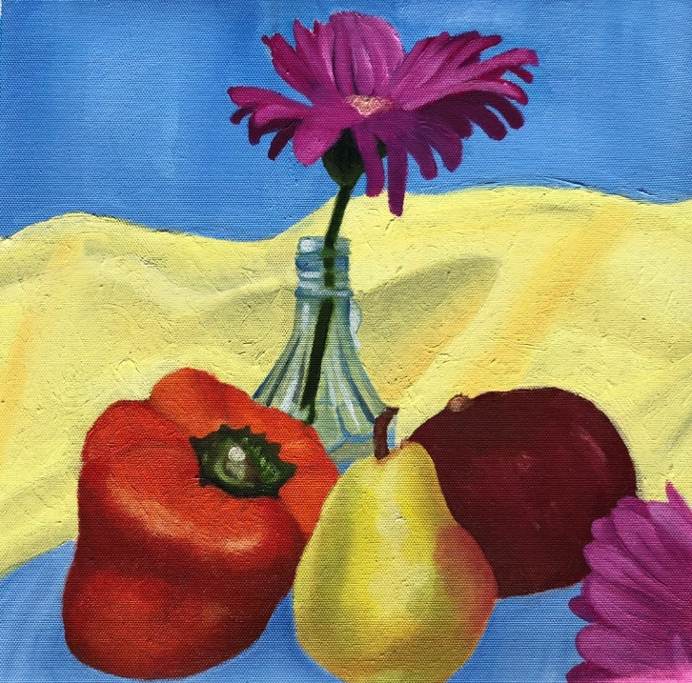
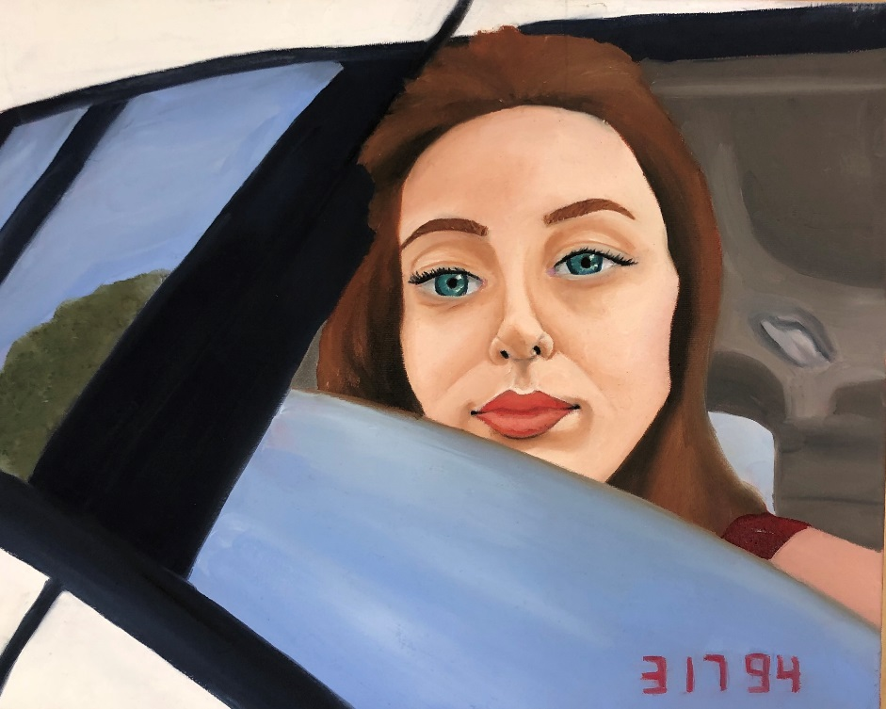
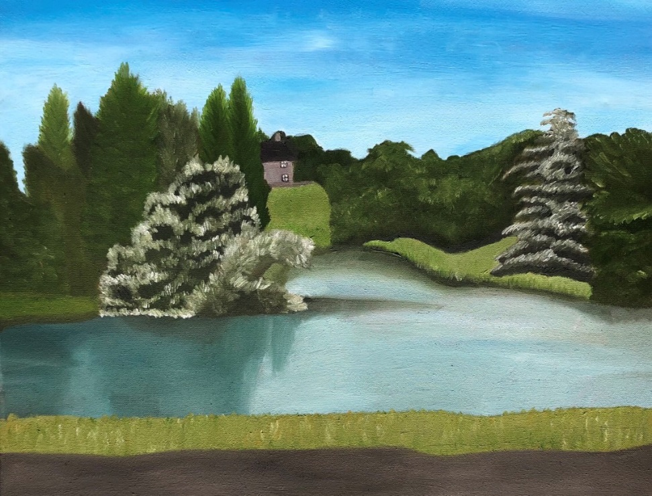
Self Portrait – Oil Paint
English Landscape – Oil Paint
Still Life – Oil Paint

Slide 6
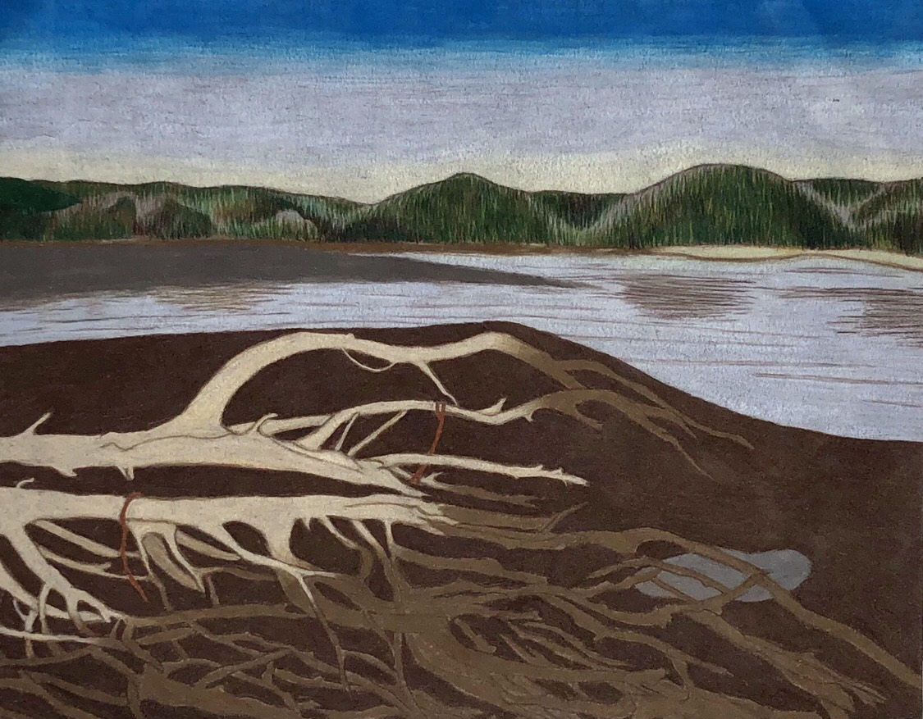
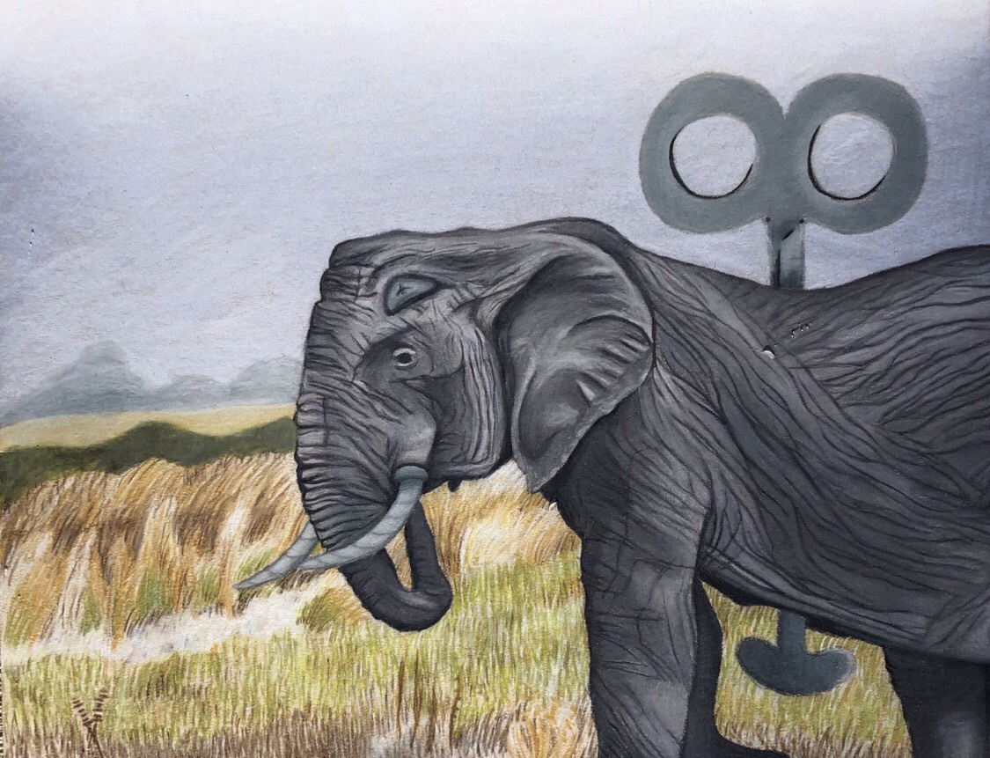
Tree - Prisma
Nature Mechanical - Prisma

Slide 7
Concentration
A body of work unified by an underlying central idea that has a visual coherence.
Mine: Places I’ve Been

Slide 8
Dover Beach, England

Slide 9
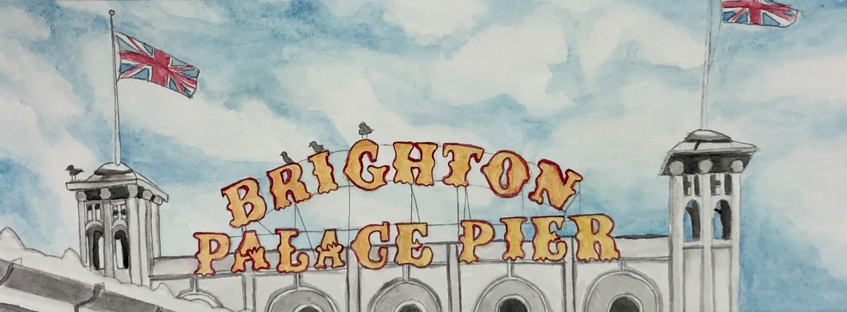
Brighton Beach, England

Slide 10
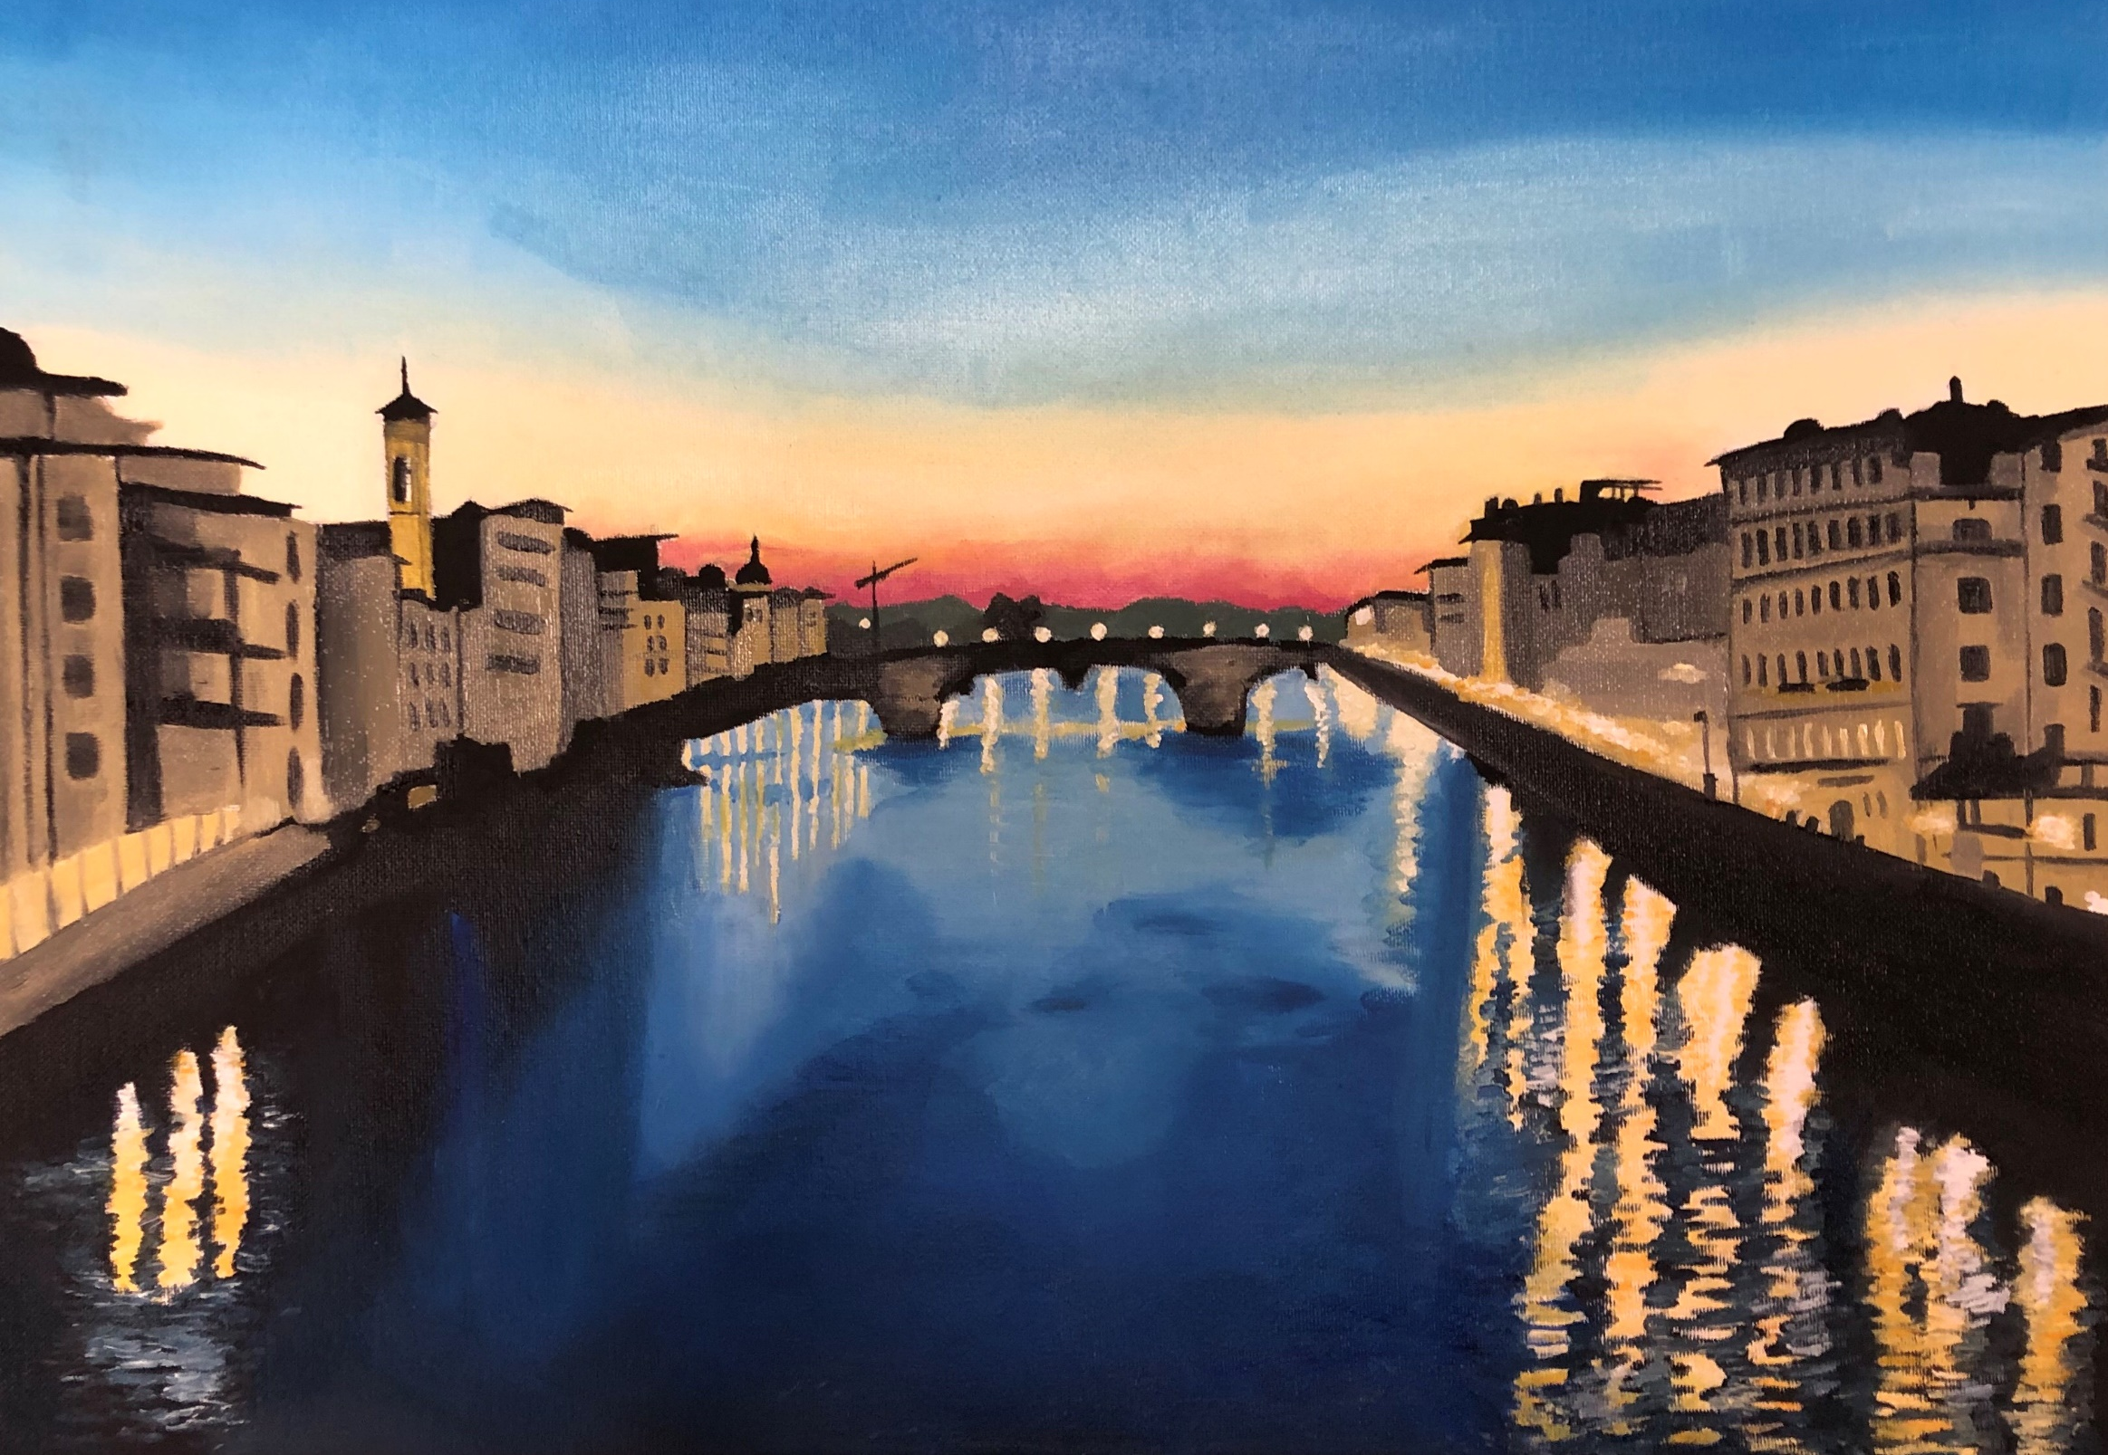
Florence, Italy

Slide 11
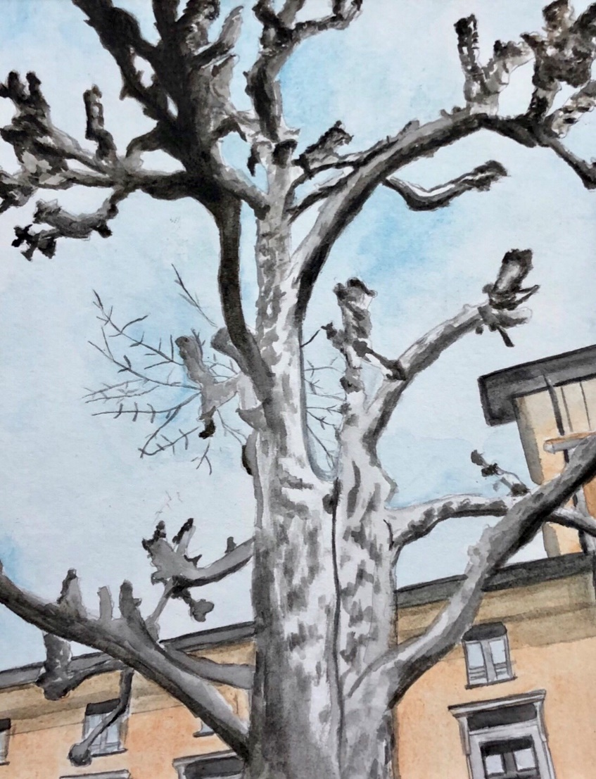
Old Town Geneva, Switzerland

Slide 12
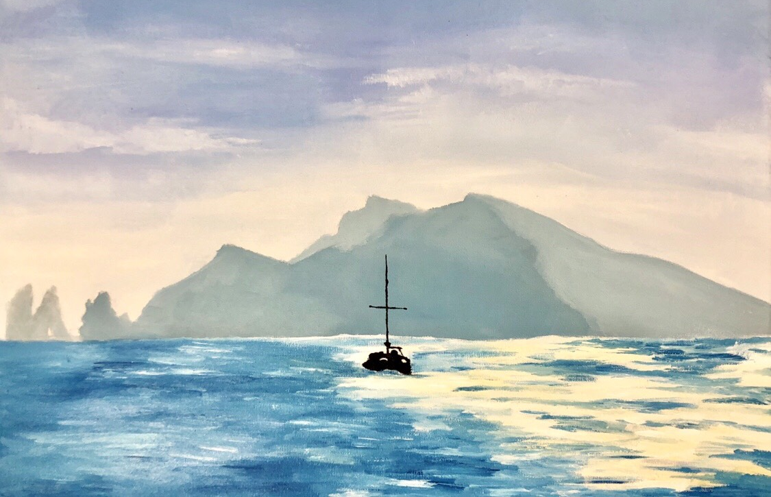
Capri, Italy

Slide 13
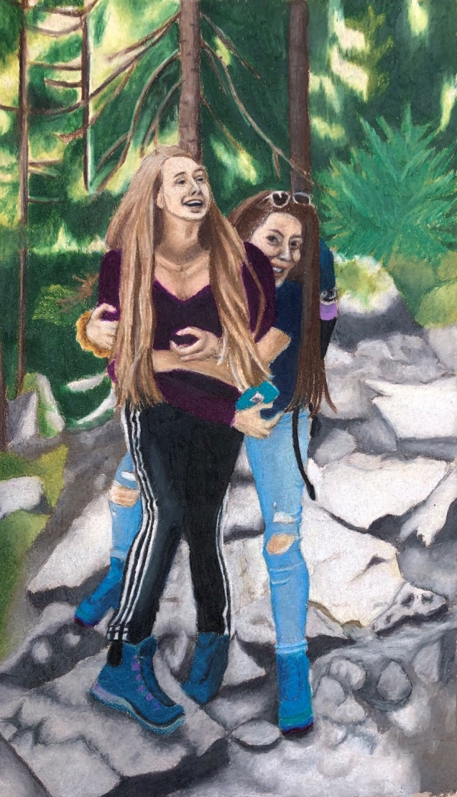
Triberg, Germany

Slide 14
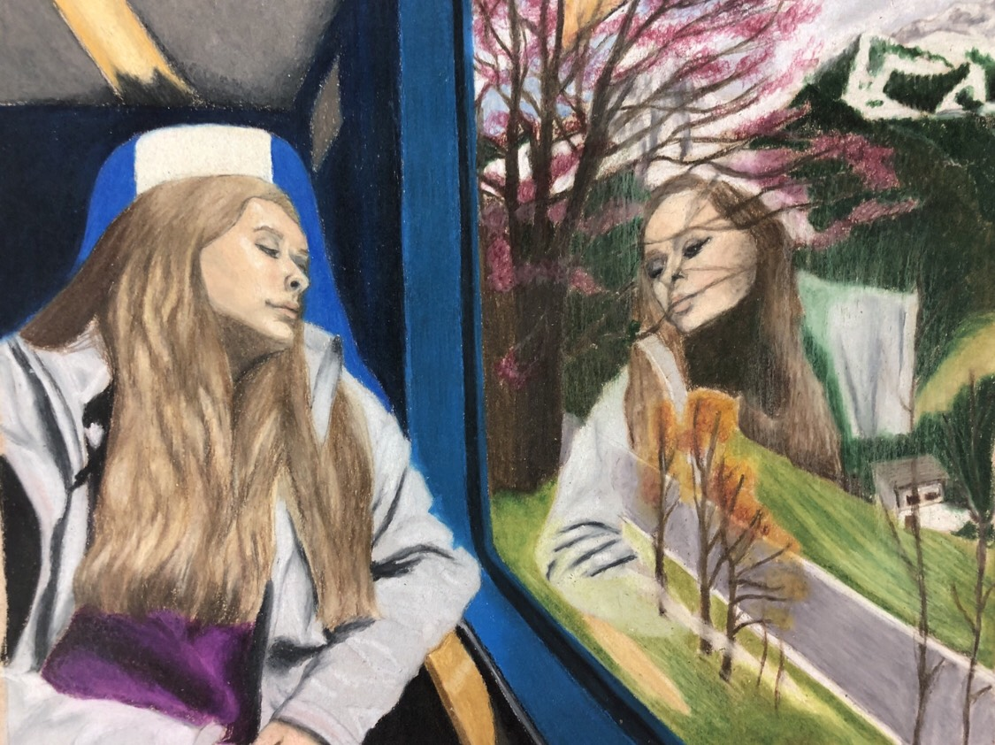
Clarens, Switzerland

Slide 15
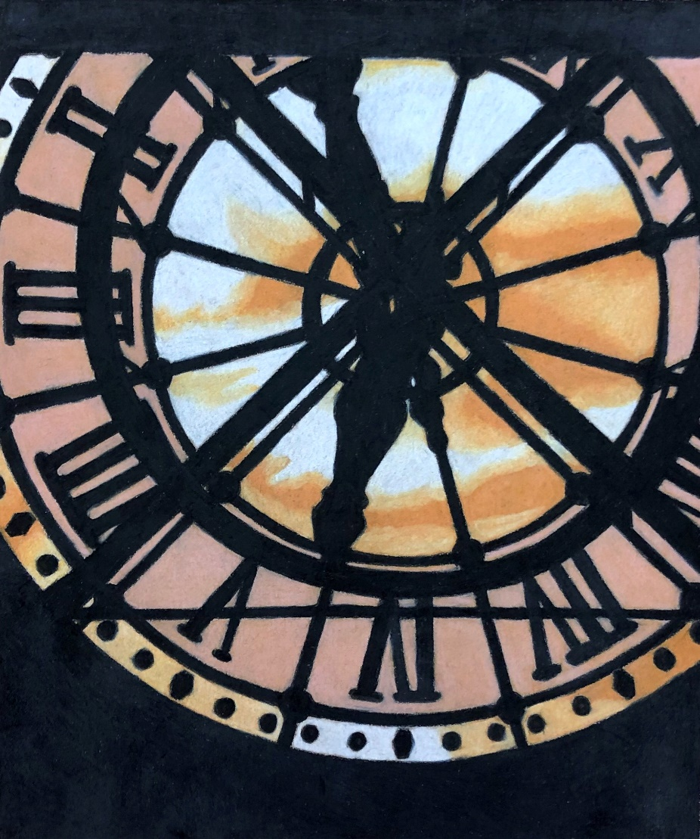
Musee d’Orsay, Paris

Slide 16
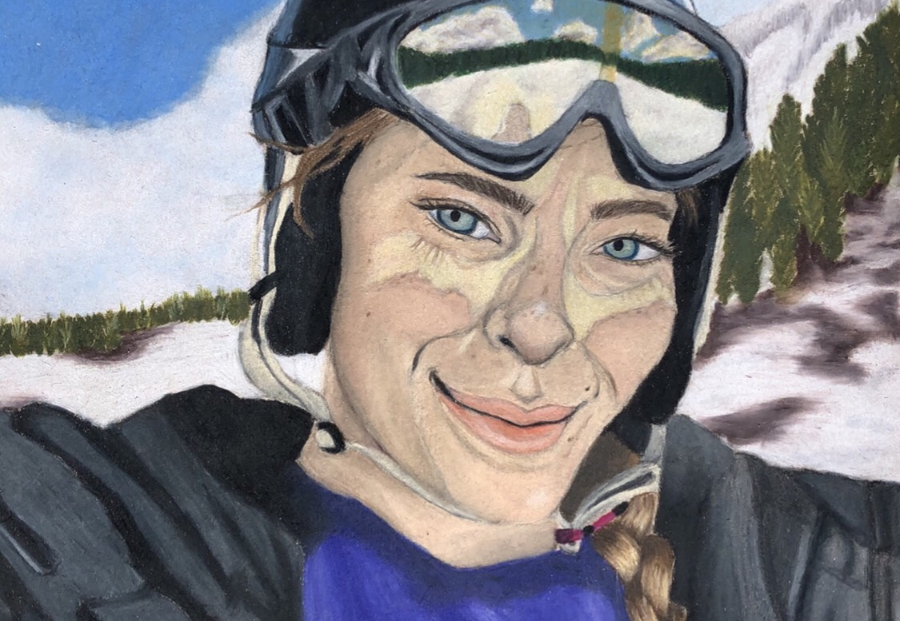
Chamonix, France

Slide 17
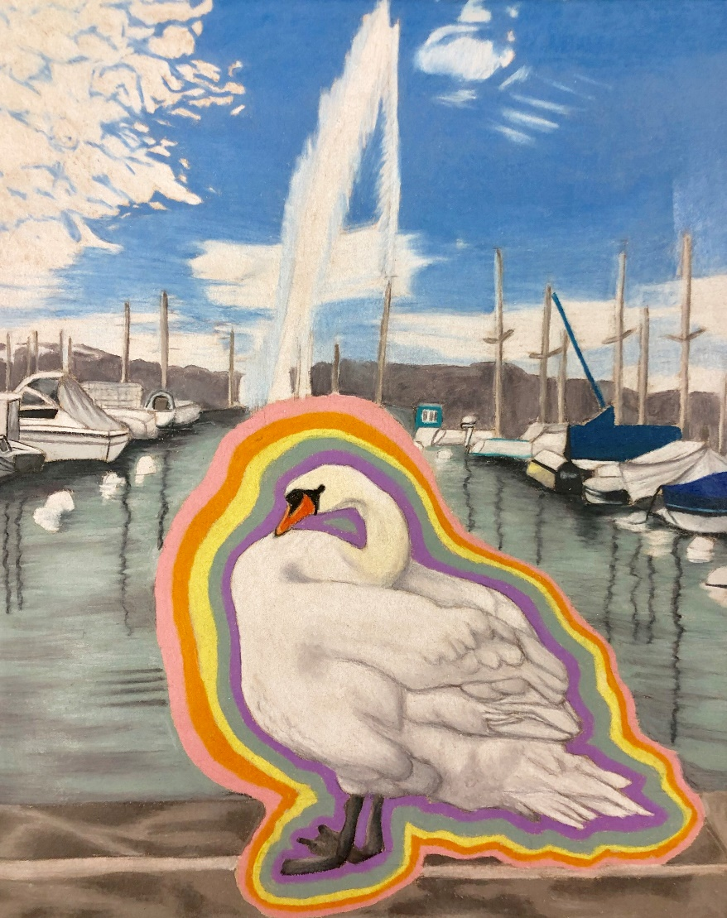
Geneva, Switzerland

Slide 18
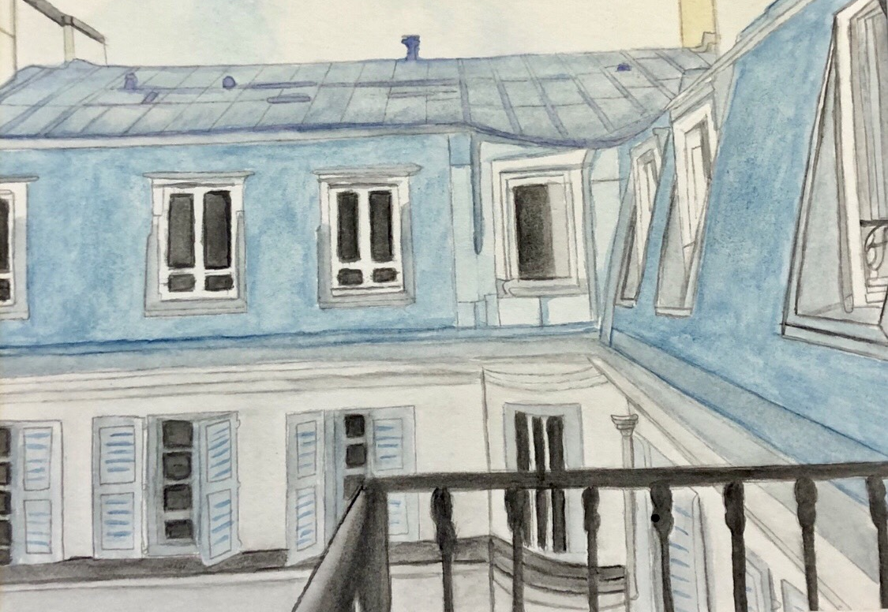
Paris, France

Slide 19
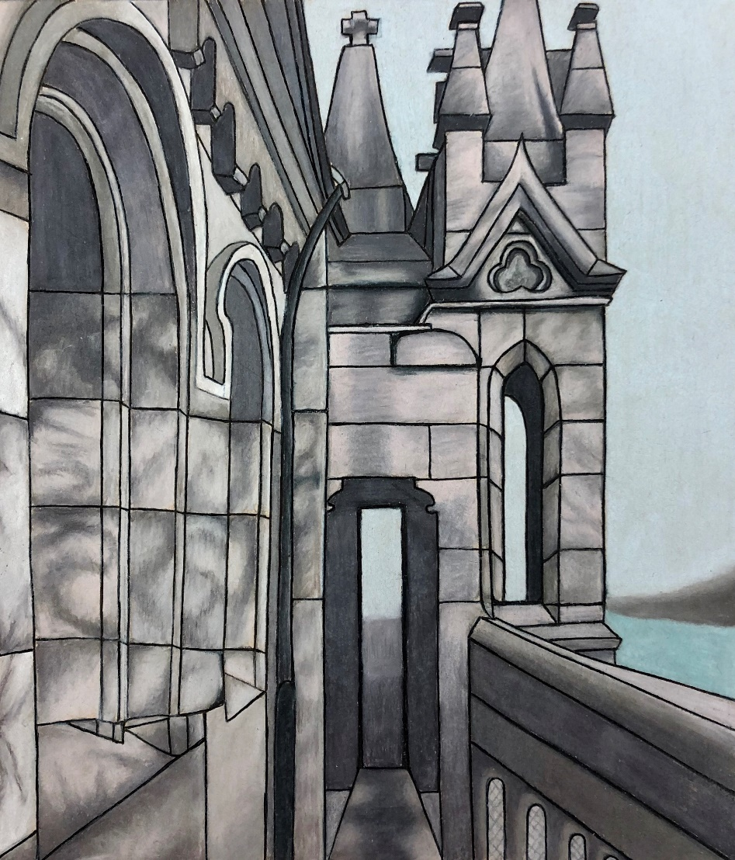
Old Town Geneva, Switzerland

